Slide 1
Murach’s ASP.NET Core MVC (2nd Ed.)
Chapter 3
How to make a web app responsive with Bootstrap

Slide 2
Objectives (part 1)
Applied
Use any of the Bootstrap CSS classes and components presented in this chapter in your web apps.
Use LibMan to add the NuGet packages for client-side libraries such as Bootstrap and Popper to a project.
Knowledge
Explain what responsive web design is and how it’s implemented using Bootstrap.
Describe how the Bootstrap grid system works.
Describe how to use the Bootstrap CSS classes to format and align labels, text boxes, and buttons within a form.
Describe how to use the Bootstrap CSS classes to format images, HTML tables, and text.

Slide 3
Objectives (part 2)
Describe how to use Bootstrap components such as button groups, icons, badges, button dropdowns, list groups, alerts, breadcrumbs, navs, and navbars.
Describe how to use Bootstrap CSS classes to provide context.
Describe how to use Bootstrap CSS classes to adjust margins and padding.

Slide 4
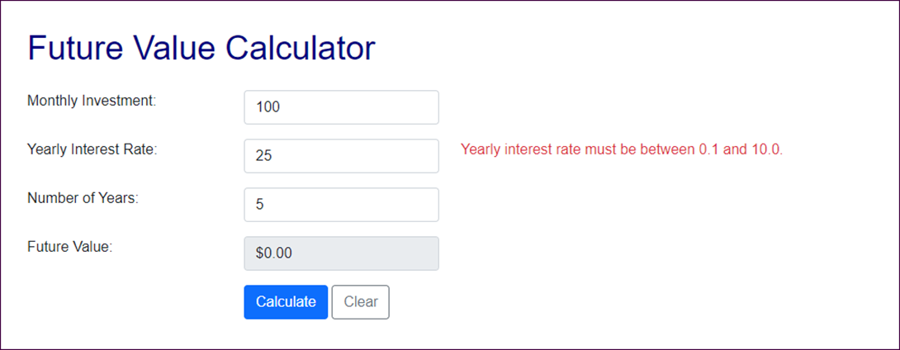
The Future Value app in a large browser

Slide 5
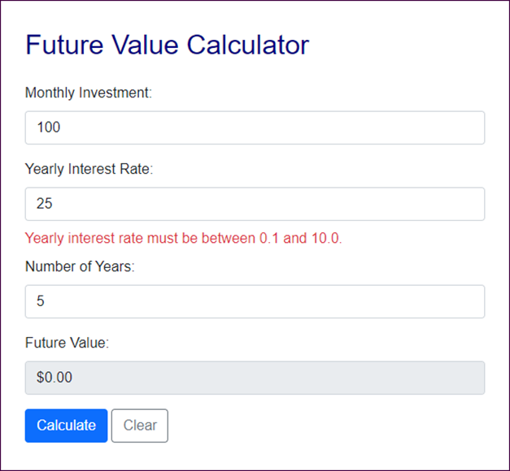
The Future Value app in a medium browser

Slide 6
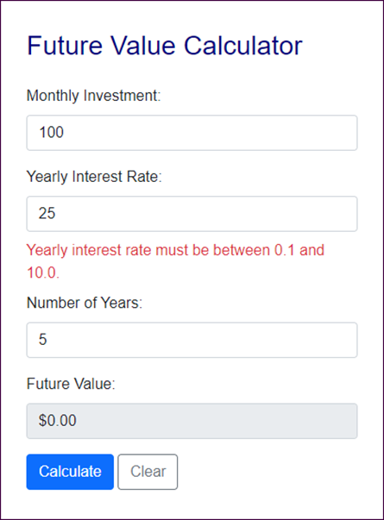
The Future Value app in a small browser

Slide 7
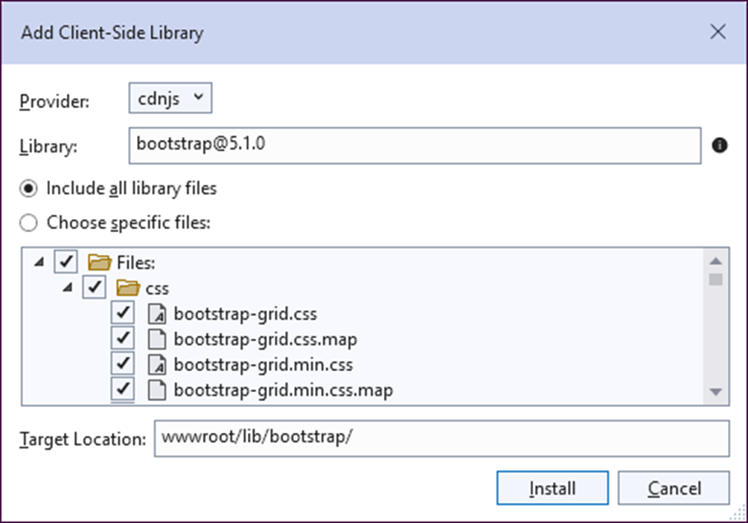
The dialog box for adding the Bootstrap library

Slide 8
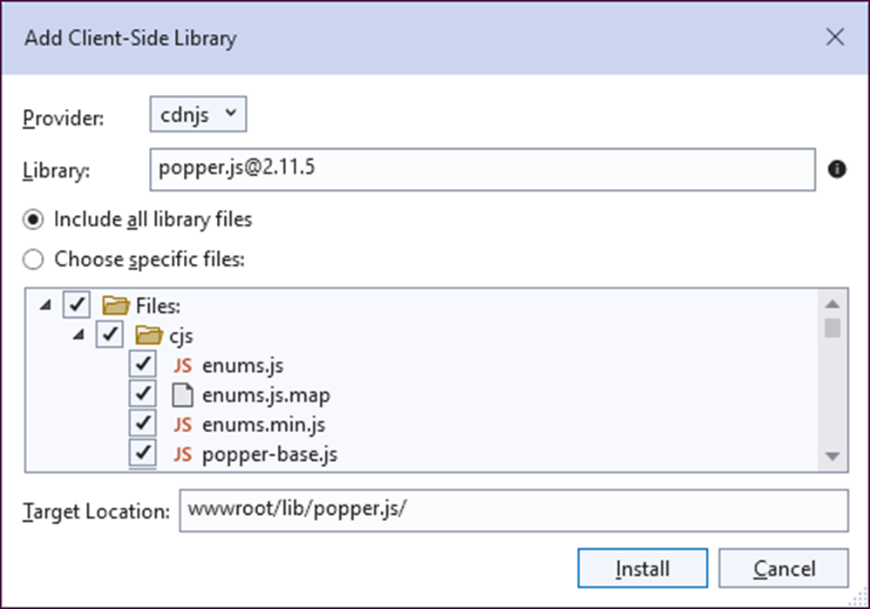
The dialog box for adding the Popper library

Slide 9
Client-side libraries included by the MVC template
twitter-bootstrap 5.1.0
jquery 3.5.1
jquery-validation 1.17.0
jquery-validation-unobtrusive 3.2.11

Slide 10
How to add the Bootstrap and Popper libraries to a web app
Start Visual Studio and open a project. In the Solution Explorer, expand the wwwroot/lib folder and delete any Bootstrap libraries.
In the Solution Explorer, right-click on the project name and select the Add→Client-Side Library item.
In the dialog that appears, type “twitter-bootstrap@5.1.0”, change the target location to “wwwroot/lib/bootstrap”, and click the Install button.
Repeat steps 2 and 3 for the library named “popper.js@2.11.5”, but don’t change the target location.

Slide 11
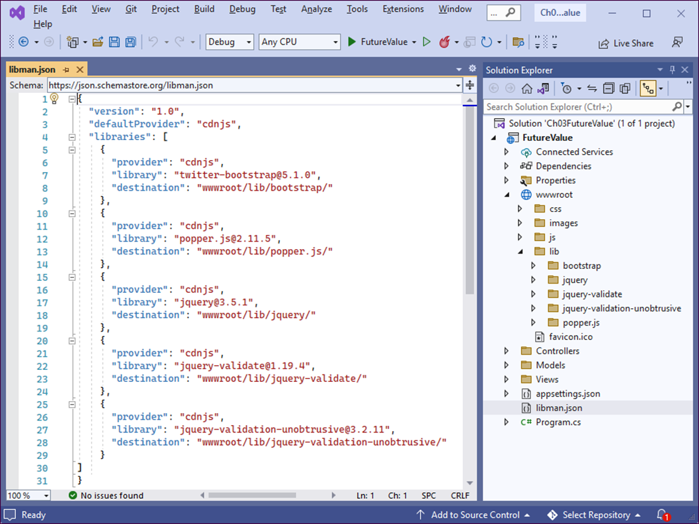
The libman.json file for the client-side libraries

Slide 12
A Razor layout that enables client-side libraries
<!DOCTYPE html>
<html>
<head>
<meta name="viewport" content="width=device-width,
initial-scale=1.0" />
<title>@ViewBag.Title</title>
<link rel="stylesheet"
href="~/lib/bootstrap/css/bootstrap.min.css" />
<link rel="stylesheet" href="~/css/site.css" />
<script src="~/lib/popper.js/umd/popper.min.js"></script>
<script src="~/lib/bootstrap/js/bootstrap.js"></script>
<script src="~/lib/jquery/jquery.min.js"></script>
<script src="~/lib/jquery-validation/jquery.validation.min.js">
</script>
<script src="~/lib/jquery-validation-unobtrusive/
jquery.validate.unobtrusive.min.js"></script>
</head>
<body>
@RenderBody()
</body>
</html>

Slide 13
An extra directory that’s included by the MVC template
<link rel="stylesheet"
href="~/lib/bootstrap/dist/css/bootstrap.min.css" />

Slide 14
The URL for the Bootstrap documentation
https://getbootstrap.com/docs/
Valid class values
container
container-fluid
row
col
col-size-count
offset-size-count

Slide 15
Valid size values
xxl
xl
lg
md
sm
(none)

Slide 16
Two columns that are automatically sized
<div class="col">Column 1</div>
<div class="col">Column 2</div>
An element that spans four columns on medium and larger screens
<div class="col-md-4">This element spans four columns</div>
An element that spans 4 columns on medium screens and 3 on large
<div class="col-md-4 col-lg-3">
This element spans three or four columns
</div>
An element that is moved one column to the right on medium screens
<div class="col-md-4 offset-md-1">
This element is offset by one column
</div>

Slide 17
The HTML for a grid exaple
<main class="container">
<div class="row">
<div class="col-12">Column 1</div>
<div class="col-12">Column 2</div>
</div>
<div class="row">
<div class="col-md-4">Column 1</div>
<div class="col-md-8">Column 2</div>
</div>
<div class="row">
<div class="col-md-4 col-sm-6">Column 1</div>
<div class="col-md-8 col-sm-6">Column 2</div>
</div>
</main>

Slide 18
Custom CSS classes that override the Bootstrap CSS classes
.row { /* custom row styles */
margin-bottom: 0.5rem;
}
.row div { /* custom column styles */
border: 1px solid black;
padding: 0.5rem;
background-color: lightsteelblue;
}

Slide 19
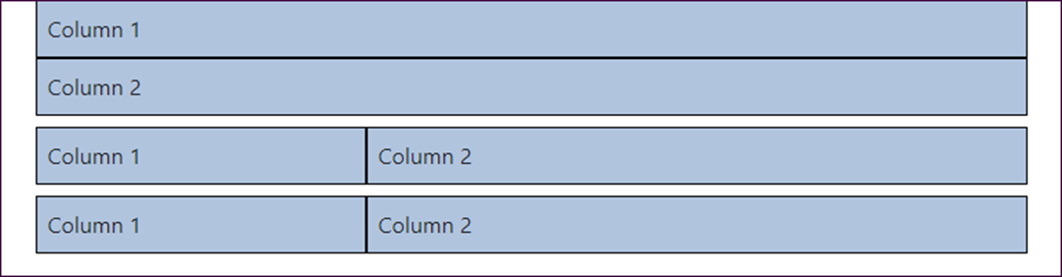
The Bootstrap grid on a medium screen

Slide 20
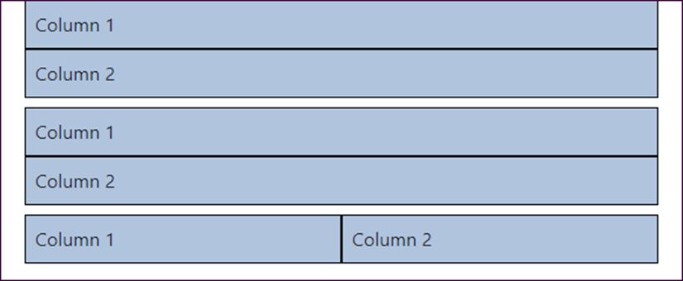
The Bootstrap grid on a small screen

Slide 21
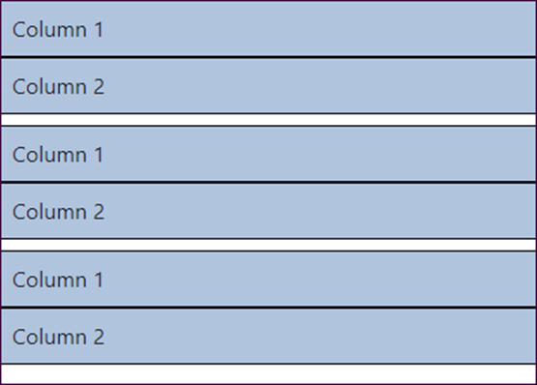
The Bootstrap grid on an extra small screen

Slide 22
Some Bootstrap CSS classes for forms
form-label
form-control
form-select
form-floating
col-form-label

Slide 23
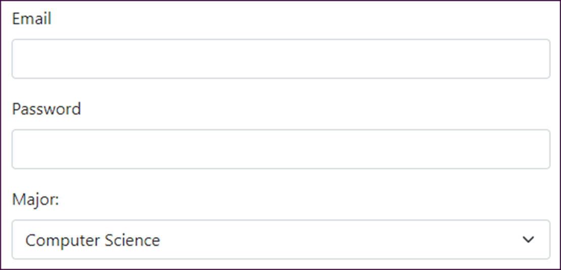
A form with two text boxes and a drop-down list in vertical layout

Slide 24
The HTML for the form in vertical layout
<form asp-action="Login" method="post">
<div class="mb-3">
<label for="email" class="form-label">Email</label>
<input id="email" type="email" class="form-control" />
</div>
<div class="mb-3">
<label for="pwd" class="form-label">Password</label>
<input id="pwd" type="password" class="form-control" />
</div>
<div>
<label for="major" class="form-label">Major:</label>
<select id="major" class="form-select">
<option value="Computer Science">
Computer Science</option>
...
<option value="Psychology">Psychology</option>
</select>
</div>
</form>

Slide 25
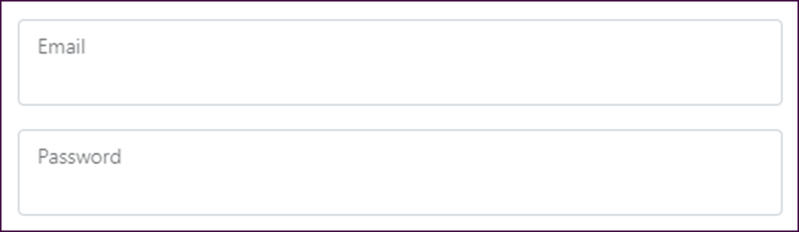
A form with two text boxes and floating labels
The HTML for the form
<form asp-action="Login" method="post">
<div class="form-floating mb-3">
<input id="email" type="email" class="form-control" />
<label for="email">Email</label>
</div>
<div class="form-floating">
<input id="pwd" type="password" class="form-control" />
<label for="pwd">Password</label>
</div>
</form>

Slide 26
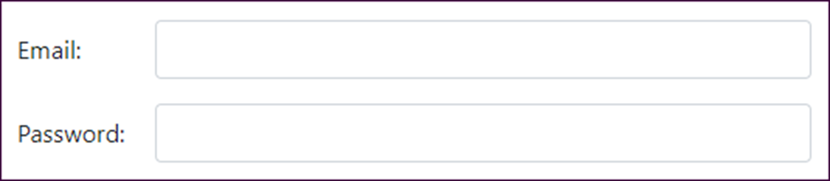
A form with two text boxes in horizontal layout

Slide 27
The HTML for the form in horizontal layout
<form asp-action="Login" method="post">
<div class="row mb-3">
<label for="email"
class="col-form-label col-md-2">Email:
</label>
<div class="col-md-10">
<input id="email" type="email"
class="form-control" />
</div>
</div>
<div class="row">
<label for="pwd"
class="col-form-label col-md-2">Password:
</label>
<div class="col-md-10">
<input id="pwd" type="password"
class="form-control" />
</div>
</div>
</form>

Slide 28
Bootstrap CSS classes for working with buttons
btn
btn-primary
btn-secondary
btn-outline-primary
btn-outline-secondary
Bootstrap CSS classes for working with images
img-fluid
rounded

Slide 29
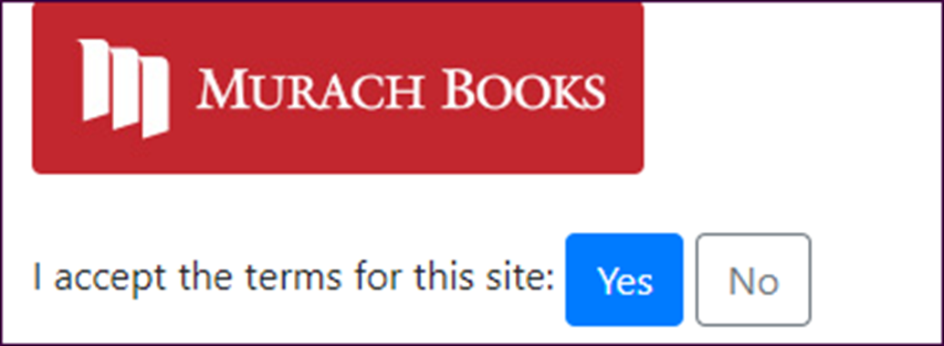
A form with an image and two buttons

Slide 30
The HTML for the image and buttons
<div class="container">
<header>
<img id="logo" alt="Murach logo"
src="~/images/MurachLogo.jpg"
class="img-fluid rounded" />
</header>
<br />
<main>
<form asp-action="Index" method="post">
<span>I accept the terms for this site:</span>
<button type="submit" class="btn btn-primary">Yes
</button>
<a asp-action="Index"
class="btn btn-outline-secondary">No
</a>
</form>
</main>
</div>

Slide 31
Bootstrap CSS classes for working with margins
mt-size
mb-size
ms-size
me-size
m-size
Bootstrap CSS classes for working with padding
pt-size
pb-size
ps-size
pe-size
p-size

Slide 32
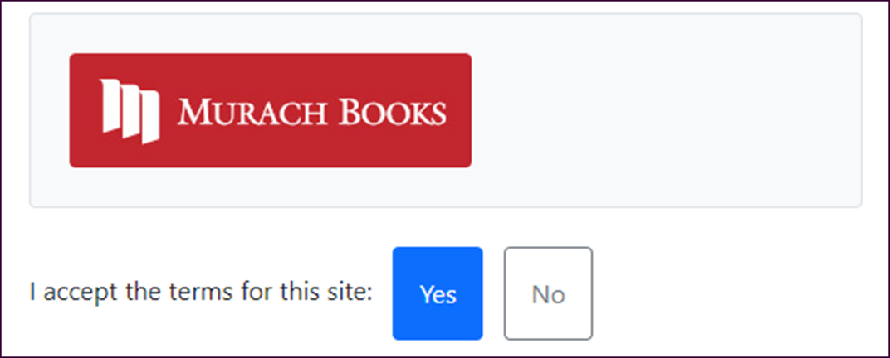
Some elements that use margins and padding

Slide 33
The HTML for the elements
<div class="container">
<header class="p-4 mt-2 mb-4 bg-light rounded border">
<img id="logo" alt="Murach logo"
src="~/images/MurachLogo.jpg"
class="img-fluid rounded" />
</header>
<main>
<form asp-action="Index" method="post">
<span class="me-2">
I accept the terms for this site:
</span>
<button type="submit"
class="btn btn-primary p-3 me-2">Yes
</button>
<a asp-action="Index"
class="btn btn-outline-secondary p-3">No
</a>
</form>
</main>
</div>

Slide 34
The code for the Index view (part 1)
@model FutureValueModel
@{
ViewData["Title"} = "Future Value Calculator";
}
<div class="container">
<h1 class="mt-3 mb-4">@ViewBag.Title</h1>
<form asp-action="Index" method="post">
<div class="row">
<label asp-for="MonthlyInvestment"
class="col-md-3 col-form-label">
Monthly Investment: </label>
<div class="col-md-3">
<input asp-for="MonthlyInvestment"
class="form-control" />
</div>
<span asp-validation-for="MonthlyInvestment"
class="col text-danger">
</span>
</div>

Slide 35
The code for the Index view (part 2)
<div class="row">
<label asp-for="YearlyInterestRate"
class="col-md-3 col-form-label">
Yearly Interest Rate: </label>
<div class="col-md-3">
<input asp-for="YearlyInterestRate"
class="form-control" />
</div>
<span asp-validation-for="YearlyInterestRate"
class="col text-danger"></span>
</div>
<div class="row">
<label asp-for="Years" class="col-md-3 col-form-label">
Number of Years: </label>
<div class="col-md-3">
<input asp-for="Years" class="form-control" />
</div>
<span asp-validation-for="Years"
class="col text-danger">
</span>
</div>

Slide 36
The code for the Index view (part 3)
<div class="row">
<label class="col-md-3 col-form-label">Future Value:
</label>
<div class="col-md-3">
<input value="@ViewBag.FutureValue" readonly
class="form-control" />
</div>
</div>
<div class="row">
<div class="col offset-md-3">
<button type="submit" class="btn btn-primary">
Calculate</button>
<a asp-action="Index"
class="btn btn-outline-secondary">Clear</a>
</div>
</div>
</form>
</div>

Slide 37
CSS classes for working with HTML tables
table
table-bordered
table-striped
table-hover
table-responsive
w-size

Slide 38
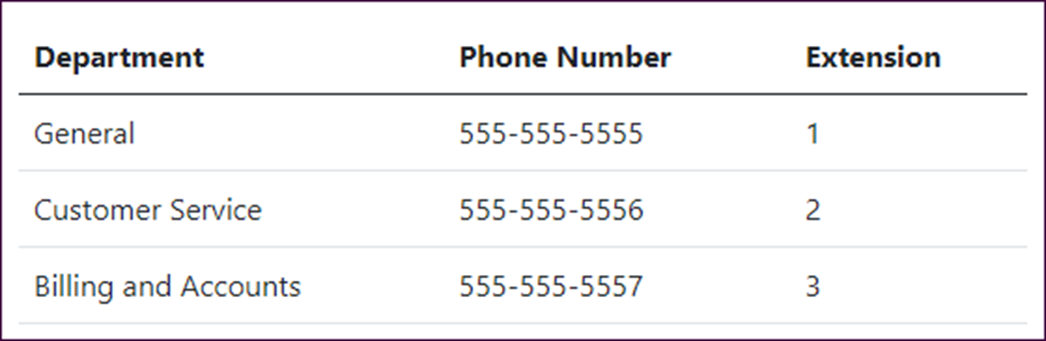
A table with default styling

Slide 39
The HTML for the table
<table class="table">
<thead>
<tr>
<th>Department</th>
<th>Phone Number</th>
<th>Extension</th></tr>
</thead>
<tbody>
<tr>
<td>General</td>
<td>555-555-5555</td>
<td>1</td></tr>
<tr>
<td>Customer Service</td>
<td>555-555-5556</td>
<td>2</td></tr>
<tr>
<td>Billing and Accounts</td>
<td>555-555-5557</td>
<td>3</td></tr>
</tbody>
</table>

Slide 40
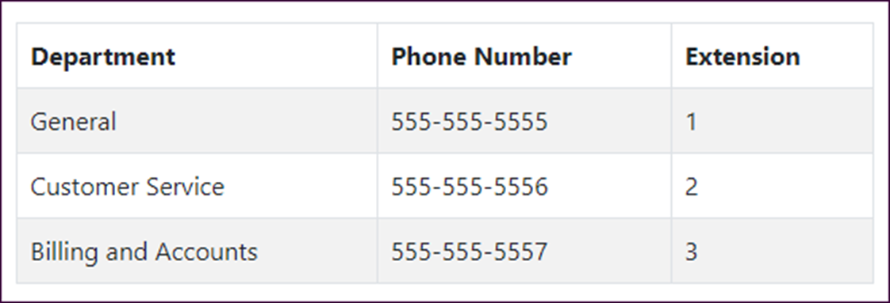
A table with alternating stripes and borders
The HTML for the table
<table class="table table-striped table-bordered table-hover">...

Slide 41
Common CSS classes for text
text-start
text-end
text-center
text-lowercase
text-uppercase
text-capitalize

Slide 42
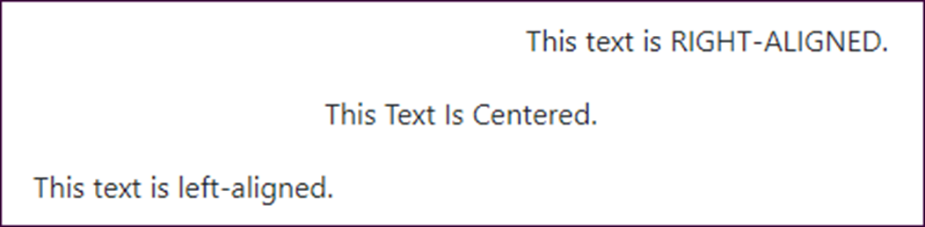
Some examples of the CSS classes for text
The HTML for the text
<p class="text-end">
This text is <span class="text-uppercase">
right-aligned</span>.
</p>
<p class="text-center">
<span class="text-capitalize">This text is centered.
</span>
</p>
<p class="text-start">
This text is <span class="text-lowercase">
LEFT-ALIGNED</span>.
</p>

Slide 43
The context classes available to most elements
Class | Default color
Primary | Dark blue
secondary | Gray
success | Green
info | Light blue
warning | Orange
danger | Red
light | Light gray
dark | Gray

Slide 44
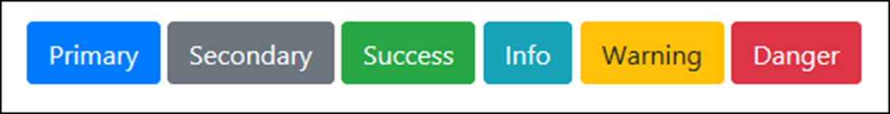
Some of the context classes applied to buttons
The HTML for the buttons
<button class="btn btn-primary">Primary</button>
<button class="btn btn-secondary">Secondary</button>
<button class="btn btn-success">Success</button>
<button class="btn btn-info">Info</button>
<button class="btn btn-warning">Warning</button>
<button class="btn btn-danger">Danger</button>

Slide 45
The success class applied to the text of an element
The HTML for the element
<p class="text-success">
Congratulations! You are now registered.
</p>

Slide 46

The warning class applied to the background of an element
The HTML for the element
<p class="bg-warning p-2 rounded">
Warning! Some required fields are empty.
</p>

Slide 47
Common CSS classes for creating button groups
btn-group
btn-toolbar
btn-group-size
btn-group-vertical

Slide 48

A basic button group
The HTML for the button group
<div class="btn-group" role="group"
aria-label="Button group">
<a href="/" class="btn btn-outline-primary">Home</a>
<a href="/cart" class="btn btn-outline-primary">
Cart</a>
<a href="/products" class="btn btn-outline-primary">
Products</a>
<a href="/contact-us" class="btn btn-outline-primary">
Contact Us</a>
</div>

Slide 49
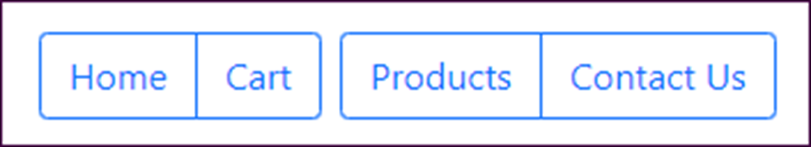
A toolbar with two button groups
The HTML for the button groups
<div class="btn-toolbar" role="toolbar"
aria-label="Toolbar with groups">
<div class="btn-group me-2" role="group"
aria-label="First group">
<a href="/" class="btn btn-outline-primary">Home</a>
<a href="/Cart" class="btn btn-outline-primary">
Cart</a>
</div>
<div class="btn-group" role="group"
aria-label="Second group">
<a href="/products" class="btn btn-outline-primary">
Products</a>
<a href="/contact-us" class="btn btn-outline-primary">
Contact Us</a>
</div>
</div>

Slide 50
The URL for the Font Awesome website
https://fontawesome.com/
A typical <link> element that enables Font Awesome icons
<link rel="stylesheet"
href="https://use.fontawesome.com/releases/v6.1.1/css/all.css"
integrity="sha-long-hash_code" crossorigin="anonymous">

Slide 51
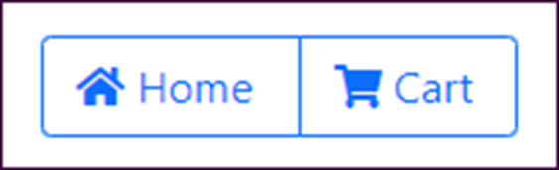
A button group that includes icons for its buttons
The HTML for the button group
<div class="btn-group" role="group"
aria-label="Button group">
<a href="/" class="btn btn-outline-primary">
<span class="fas fa-home"></span>&nbsp;Home&nbsp;
</a>
<a href="/cart" class="btn btn-outline-primary">
<span class="fas fa-shopping-cart"></span>
&nbsp;Cart&nbsp;
</a>
</div>

Slide 52

A button with a badge
The HTML for the button
<a href="/cart" class="btn btn-outline-primary">
&nbsp;Cart&nbsp;
<span class="badge bg-primary">2</span>
</a>

Slide 53

A button with an icon and a badge
The HTML for the button
<a href="/cart" class="btn btn-outline-primary">
<span class="fas fa-shopping-cart"></span>
&nbsp;Cart&nbsp;
<span class="badge bg-primary">2</span>
</a>

Slide 54
CSS classes for creating button dropdowns
dropdown
dropdown-toggle
dropdown-menu
dropdown-item
dropup
An HTML data attribute for creating button dropdowns
data-bs-toggle

Slide 55
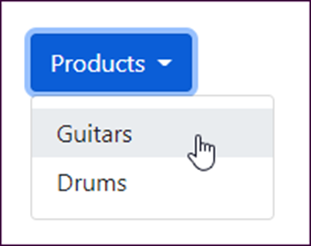
A button dropdown
The HTML for the button dropdown
<div class="dropdown">
<button type="button" class="btn btn-primary dropdown-toggle"
id="productsDropdown" data-bs-toggle="dropdown"
aria-haspopup="true" aria-expanded="false">Products
</button>
<div class="dropdown-menu" aria-labelledby="productsDropdown">
<a class="dropdown-item"
href="/product/list/guitars">Guitars</a>
<a class="dropdown-item"
href="/product/list/drums">Drums</a>
</div>
</div>

Slide 56
Common CSS classes for creating list groups
list-group
list-group-numbered
list-group-item
active
disabled

Slide 57
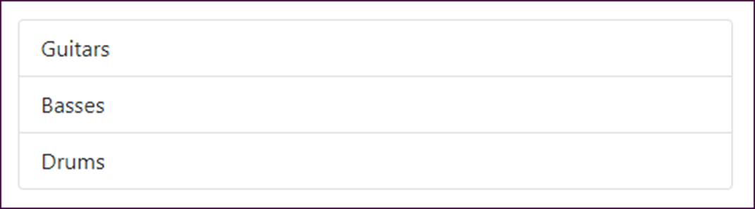
A basic list group
The HTML for the list group
<ul class="list-group">
<li class="list-group-item">Guitars</li>
<li class="list-group-item">Basses</li>
<li class="list-group-item">Drums</li>
</ul>

Slide 58
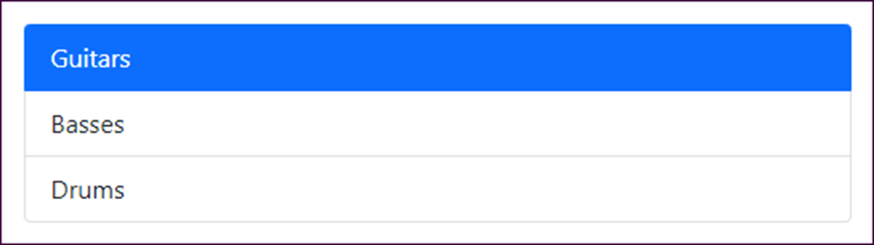
Another basic list group with an active item
The HTML for the list group
<div class="list-group">
<a href="/guitars" class="list-group-item active">
Guitars</a>
<a href="/basses" class="list-group-item">Basses</a>
<a href="/drums" class="list-group-item">Drums</a>
</div>

Slide 59
Common CSS classes for creating alerts
alert
alert-context
alert-dismissible
alert-link
btn-close
An HTML5 data attribute for creating alerts
data-bs-dismiss

Slide 60
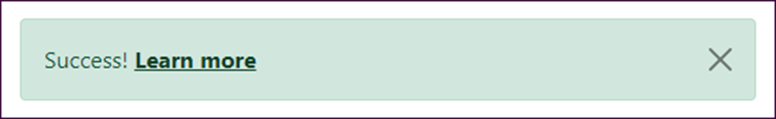
A dismissible alert with a link
The HTML for the alert
<div class="alert alert-success alert-dismissible">
Success!
<a href="#" class="alert-link">Learn more</a>
<button class="btn-close" data-bs-dismiss="alert">
</button>
</div>

Slide 61
Common CSS classes for creating breadcrumbs
breadcrumb
breadcrumb-item
active

Slide 62

A breadcrumb with three segments
The HTML for the breadcrumb
<nav aria-label="breadcrumb">
<ol class="breadcrumb">
<li class="breadcrumb-item">
<a href="/">Home</a></li>
<li class="breadcrumb-item">
<a href="/Products">Products</a></li>
<li class="breadcrumb-item active"
aria-current="page">Guitars</li>
</ol>
</nav>

Slide 63
Common CSS classes for creating navs
nav
nav-tabs
nav-pills
nav-item
nav-link
active

Slide 64
Nav links styled as tabs
The HTML for the nav links
<nav class="nav nav-tabs">
<a class="nav-item nav-link active" href="/">Home</a>
<a class="nav-item nav-link" href="/products">
Products</a>
<a class="nav-item nav-link" href="/cart">Cart</a>
</nav>

Slide 65
The same nav links styled as pills
<nav class="nav nav-pills">
<a class="nav-item nav-link active" href="/">Home</a>
<a class="nav-item nav-link" href="/products">
Products</a>
<a class="nav-item nav-link" href="/cart">Cart</a>
</nav>

Slide 66
A more verbose way of coding the same nav links
<ul class="nav nav-pills">
<li class="nav-item">
<a class="nav-link active" href="/">Home</a>
</li>
<li class="nav-item">
<a class="nav-link" href="/products">Products</a>
</li>
<li class="nav-item">
<a class="nav-link" href="/cart">Cart</a>
</li>
</ul>

Slide 67
Common CSS classes for creating navbars
navbar
navbar-expand-size
navbar-light-or-dark
navbar-brand
navbar-toggler
navbar-collapse
collapse
navbar-nav
HTML data attributes for creating navbars
data-bs-toggle
data-bs-target

Slide 68

A navbar expanded on a wide screen
A navbar collapsed on a small screen

Slide 69
The HTML for the navbar (part 1)
<nav class="navbar navbar-expand-md navbar-dark bg-primary">
<div class="container-fluid">
<a class="navbar-brand" href="/">My Guitar Shop</a>
<button class="navbar-toggler" type="button"
data-bs-toggle="collapse"
data-bs-target="#navbarSupportedContent"
aria-controls="navbarSupportedContent"
aria-expanded="false"
aria-label="Toggle navigation">
<span class="navbar-toggler-icon"></span>
</button>
<nav class="collapse navbar-collapse"
id="navbarSupportedContent">
<div class="navbar-nav me-auto">
<a class="nav-item nav-link active" href="/">Home</a>
<a class="nav-item nav-link"
href="/products">Products</a>
<a class="nav-item nav-link" href="/about">About</a>
</div>

Slide 70
The HTML for the navbar (part 2)
<div class="navbar-nav ms-auto">
<a class="nav-item nav-link" href="/cart">
<span class="fas fa-shopping-cart"></span>
&nbsp;Cart&nbsp;
<span class="badge badge-primary ms-2">2</span>
</a>
</div>
</nav>
</div>
</nav>

Slide 71
More CSS classes for positioning navbars
fixed-top
fixed-bottom

Slide 72
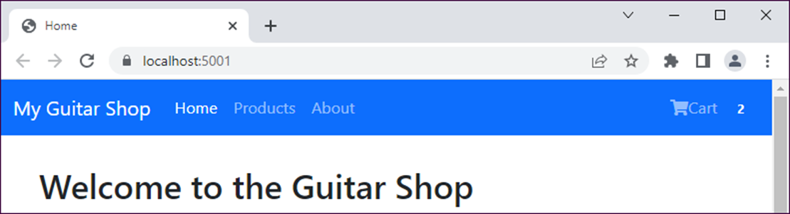
A navbar that’s fixed at the top of the screen

Slide 73
The HTML that displays the navbar
<body>
<nav class="navbar navbar-expand-md navbar-dark
bg-primary fixed-top">
<div class="container-fluid">
<!-- navbar items go here -->
</div>
</nav>
<div class="container">
<!-- container items go here -->
</div>
</body>
The CSS that sets the top margin
body {
margin-top: 70px;
}

Slide 74
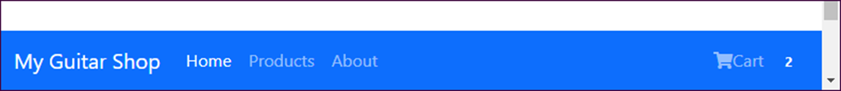
A navbar that’s fixed at the bottom of the screen

